Slide 1
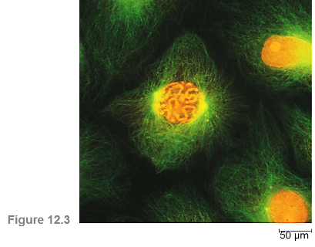
Cell Biology Lec (10)
DNA and Chromosomes

Slide 2
DNA and Chromosomes
A Genome = complete collection of an organism’s genetic information as linked genes in one or more long strands of DNA
An average eukaryotic cell has about 1,000 times more DNA then an average prokaryotic cell.
The DNA in a eukaryotic cell is organized into several linear chromosomes, whose organization is much more complex than the single, circular DNA molecule in a prokaryotic cell.
All eukaryotic cells store genetic information in chromosomes.

Slide 3
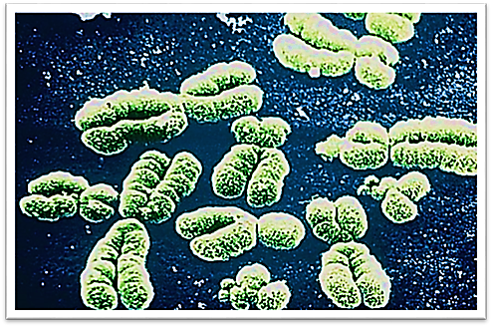
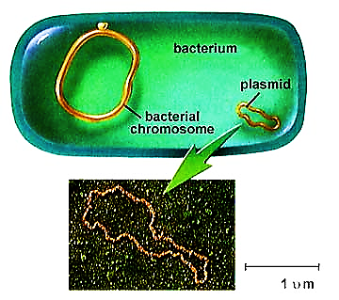

Slide 4
Structure of Chromosomes
Chromosomes are composed of a complex of DNA and protein called chromatin that condenses during cell division.
Each unduplicated chromosome contains one DNA molecule.
The DNA wraps twice around a group of histone proteins to form a nucleosome.

Slide 5
Structure of Chromosomes
Higher order coiling and supercoiling also help condense and package the chromatin inside the nucleus.
Because DNA is packaged into chromosomes, when it divides, the chromosomes also divide
A replicated chromosome is comprised of two daughter DNA molecules held together.
The daughter DNA molecules are called “sister chromatids”

Slide 6
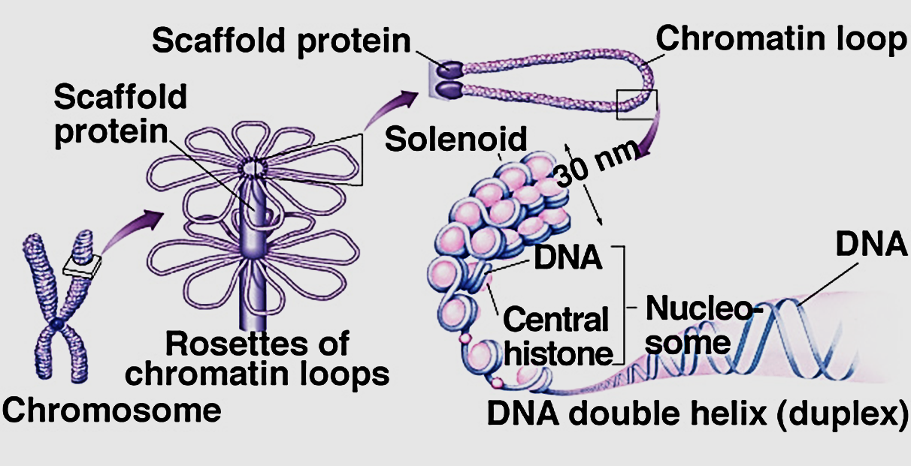

Slide 7
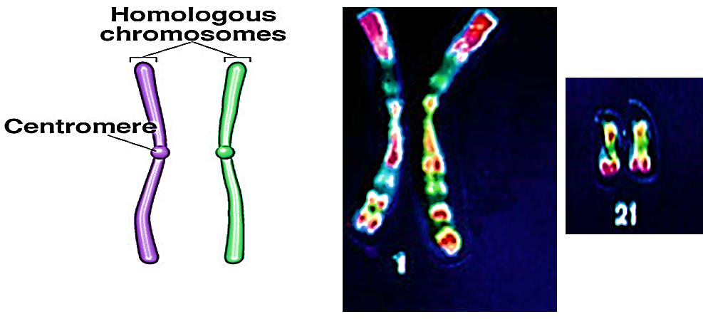
Structure of Chromosomes
Many eukaryotes carry two copies of each chromosome in the genome; Pairs of like chromosomes are called homologous chromosomes.

Slide 8

Structure of Chromosomes
Sex chromosomes: humans and other mammals use chromosomes to distinguish between the sexes.
  Males have one X and one Y.
  Females have two Xs.
Diploid: A cell possessing two copies of each chromosome (human body cells).
    Homologous chromosomes are made up of sister chromatids joined at the centromere.
Haploid: A cell possessing a single copy of each chromosome (human sex cells).

Slide 9
Karyotype
Karyotype: is the appearance of chromosomes in the nucleus of a eukaryotic cell including number, design and size of chromosomes.
Chromosomes are photographed when they are highly condensed, then photos of the individual chromosomes are arranged in order of decreasing size.
In humans each somatic cell has 46 chromosomes, made up of two sets, one set of chromosomes comes from each parent.

Slide 10
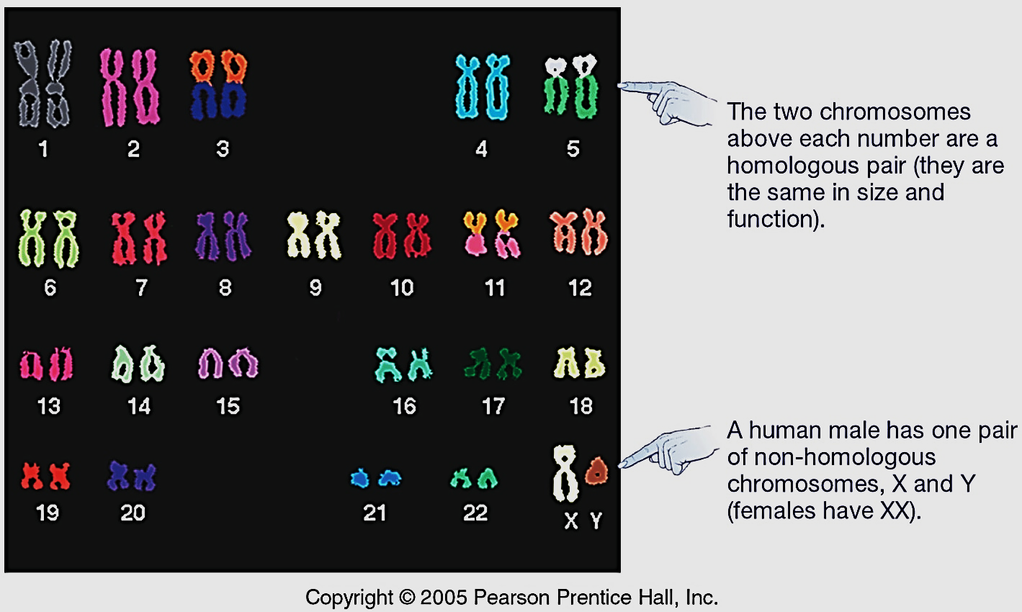

Slide 11
Chromosome Duplication
In preparation for cell division, DNA is replicated and the chromosomes condense.
Each duplicated chromosome has two sister chromatids, joined by a centromere which separate during cell division.
The centromere is a constricted region of the chromosome containing a specific DNA sequence, to which is bound 2 discs of protein called kinetochores.
Kinetochores serve as points of attachment for microtubules that move the chromosomes during cell division.

Slide 12
